Slide 1
Adversarial Robustness in Machine Learning Models
Nischay Uppal, SAI COUMAR, Supriya Dixit, Patrick Florenda

Slide 2
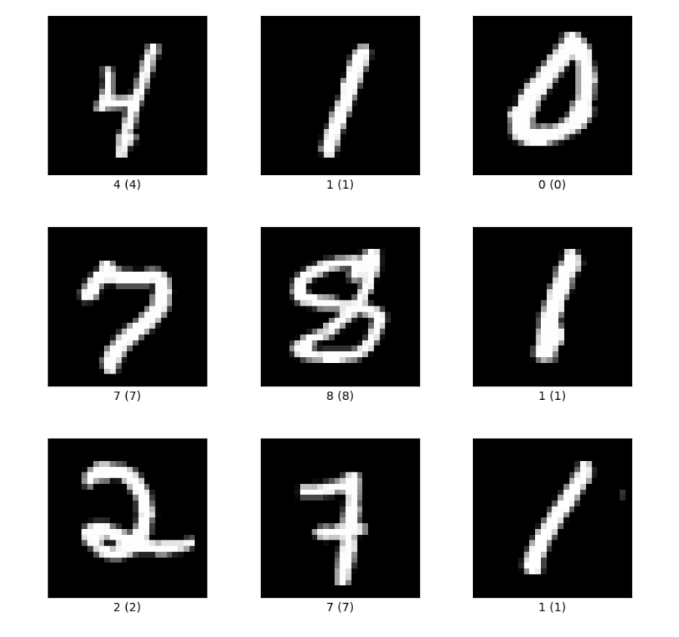
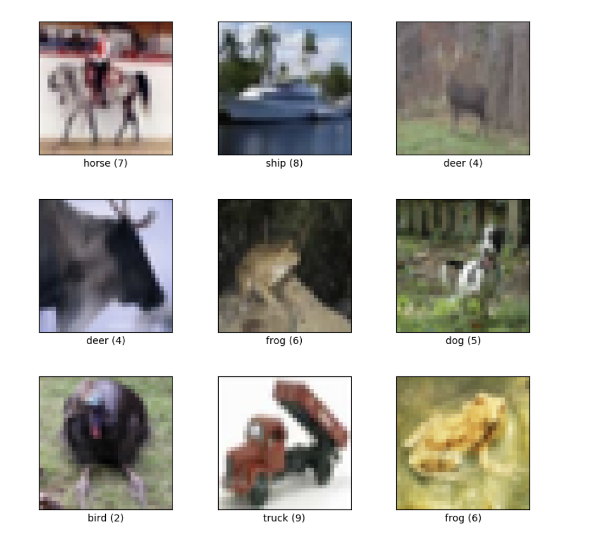
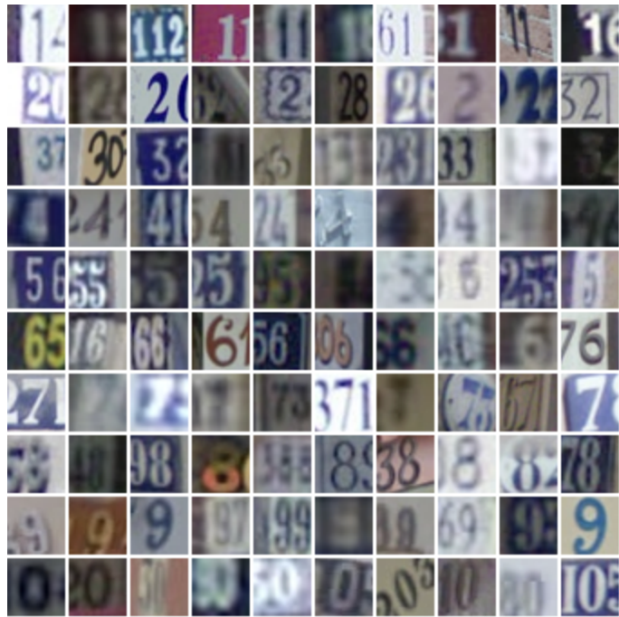
Metadata
MNIST
CIFAR10
SVHN
60,000 28x28 images
50,000 32x32 images
73,257 32x32 images

Slide 3
Metadata
 | MNIST | CIFAR10 | SVHN
Training Quantity | 60,000 images | 50,000 images | 73,257 images
Data Storage | CSV | 5 Batch Files | Matlab Files
Data Format | Flattened One-Hot Encoding Vectors | Flattened One-Hot-Encoding Vectors | Table of Matrices
Image Representation Dimensions (height x width x #channels) | 28 x 28 x 1 | 32 x 32 x 3 | 32 x 32 x 3
Available Features (pixels + 1 label) | 785 | 3073 | 3073
Pixel Value | [0,255] | [0,255] | [0,255]
Cleaning Process | N/A | N/A | N/A

Slide 4

Data Representation
 | MNIST | CIFAR10 | SVHN
Flattened One-Hot Encoding Vectors
Image Representation
 | MNIST | CIFAR10 | SVHN
Flattened One-Hot Encoding Vectors
Image Representation
PyTorch Tensor
*Image Representation: height x width x # channels
PyTorch Tensor: #channels x height x width

Slide 5
Data Augmentation & Integration
Image Transformations yielded subpar results (10-20% poorer performance, hence omitted)
Rotations
Cropping
Reflections
Single Attribute Modifications: CIFAR10 label values mappings (post-modeling)
Data Integration
Datasets remain disjoint as underlying distributions are significantly different
*there is no account of derived attributes or generated records

